Slide 1
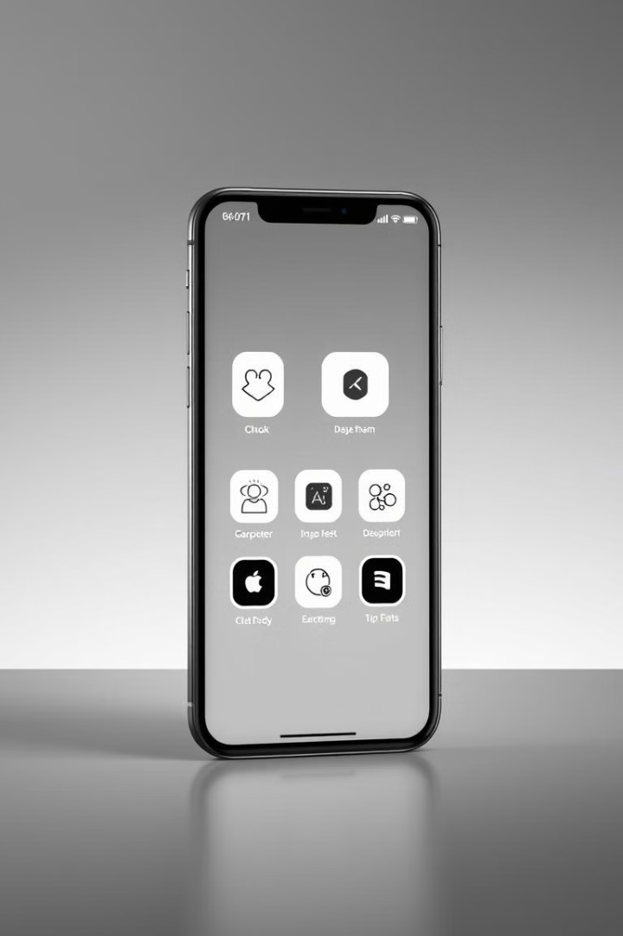

AppDock: A Unified Mobile App Experience
Welcome to the presentation of AppDock, a revolutionary mobile app platform that simplifies digital interaction and streamlines user experiences.
}
“
Bibhu Basnet
Jia Zhang
Team Members
Mohd Abdul Subhan
Sai Chandhu

Slide 2

The Challenge: Fragmented User Experiences
The Problem
The Solution
Users often struggle with fragmented app experiences.
AppDock centralizes and integrates app usage.

Slide 3
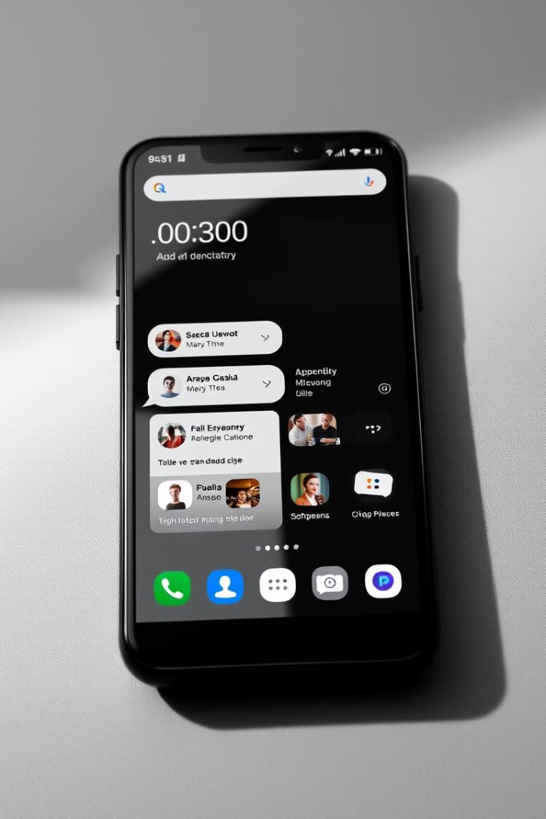
AppDock's Core Features
1
App Hub
2
Communication Module
Organize and access favorite apps seamlessly.
Support for individual and group chats.
3
Content Sharing Module
Seamlessly share files and media across platforms.

Slide 4
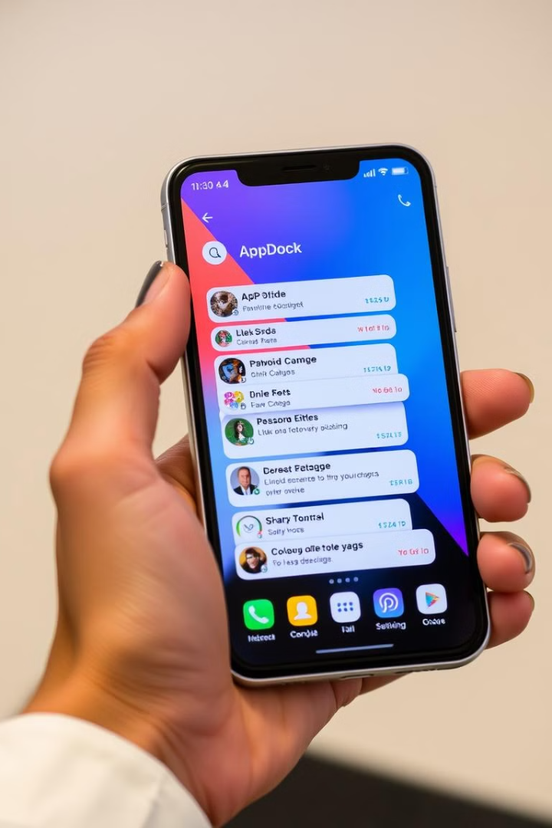

User-Centric Design
Target Audience
Focus
Professionals, students, and anyone using multiple apps.
Convenience, efficiency, and improved organization.
Goal
Provide a user-friendly and seamless experience.

Slide 5
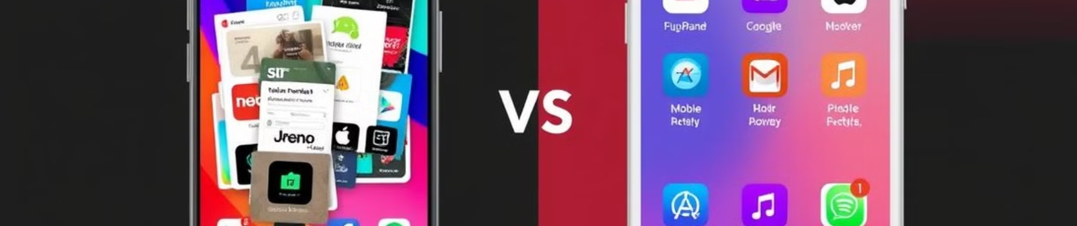




The AppDock Advantage
Save Time
Minimize Clutter
Boost Efficiency
Reduce time switching between apps.
Streamline digital interactions.
Increase productivity and organization.

Slide 6


Unifying Communication
1
2
3
Individual Chats
Group Conversations
Cross-Platform Sharing
Connect with friends and colleagues directly.
Facilitate collaboration and shared communication.
Share files and media seamlessly across apps.

Slide 7
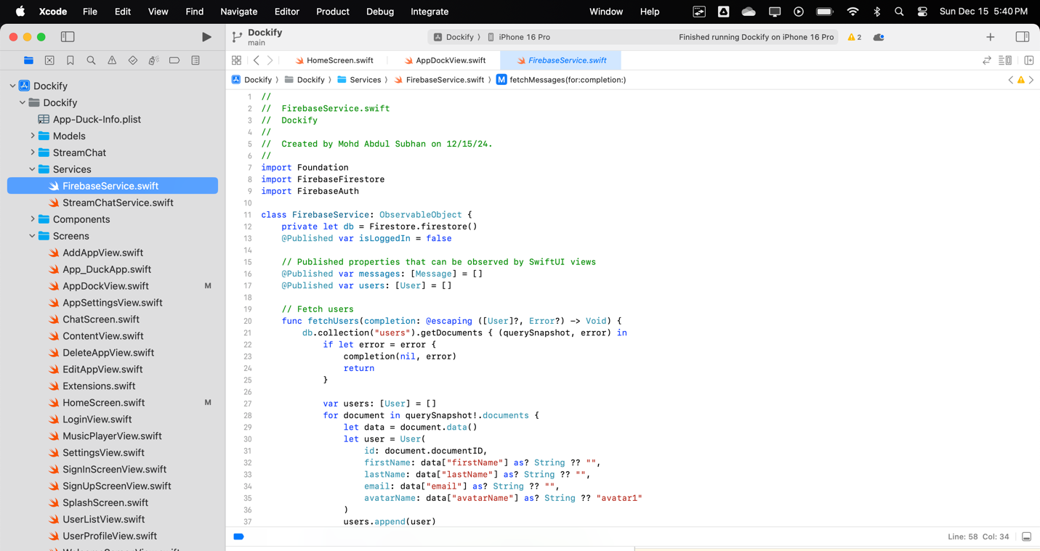

2Coding Part:
21.

Slide 8
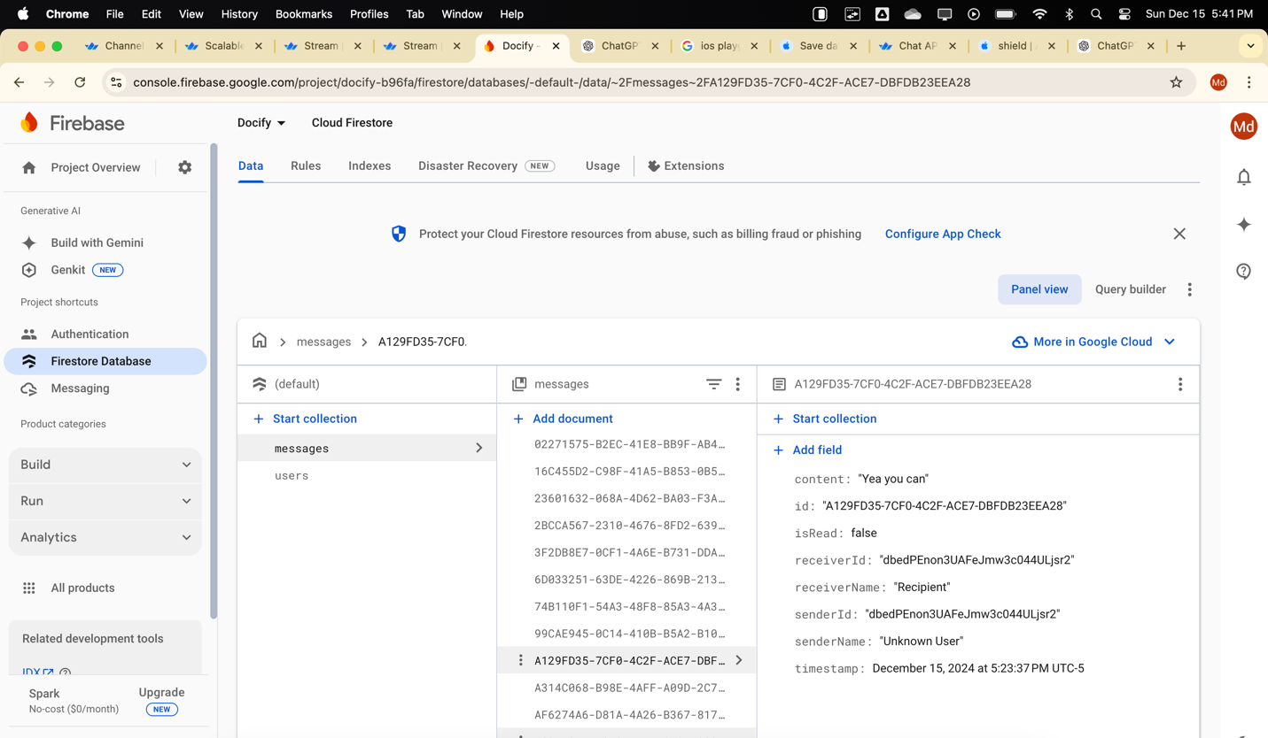

22.

Slide 9
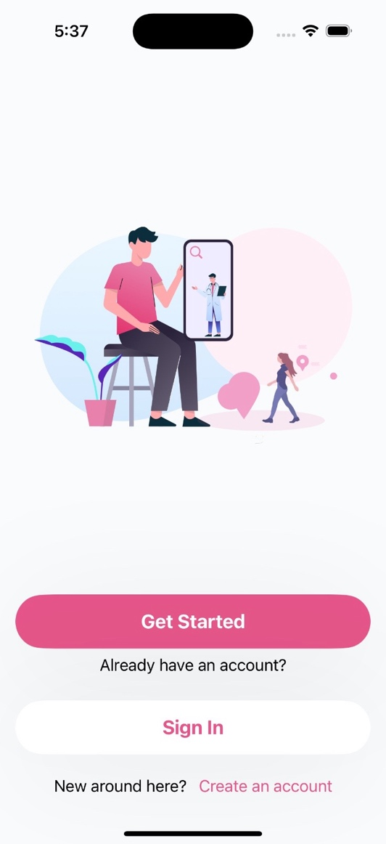
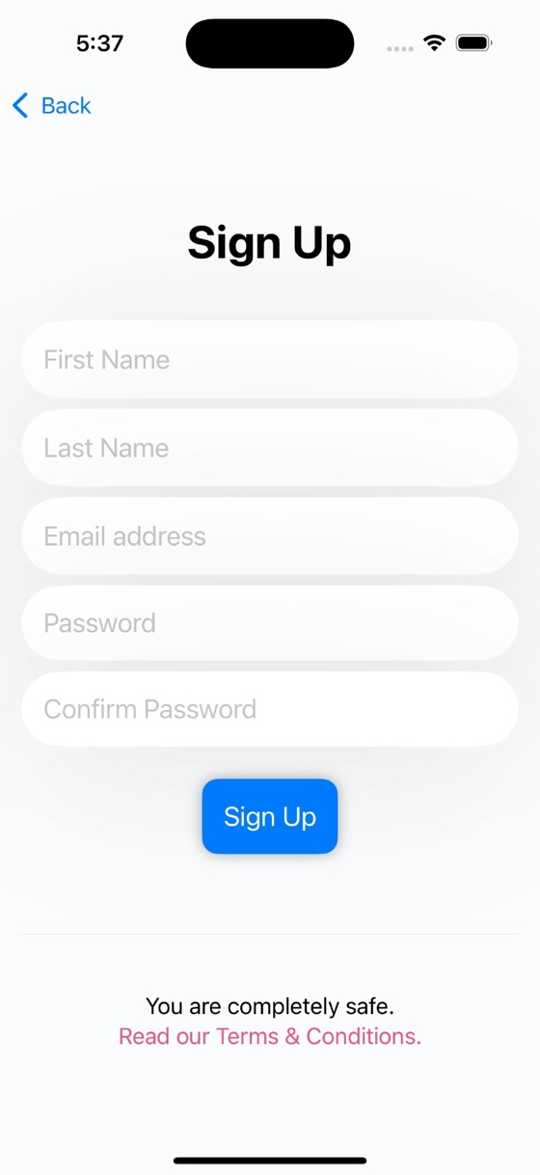


2Working of App:
1.
1.
2.

Slide 10
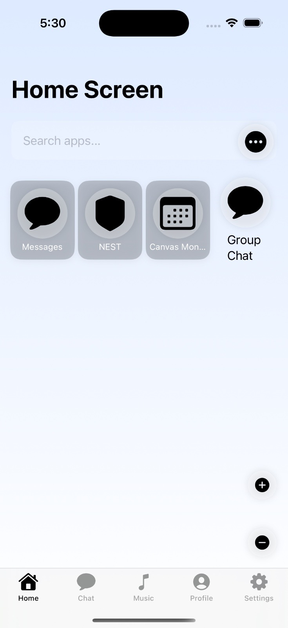
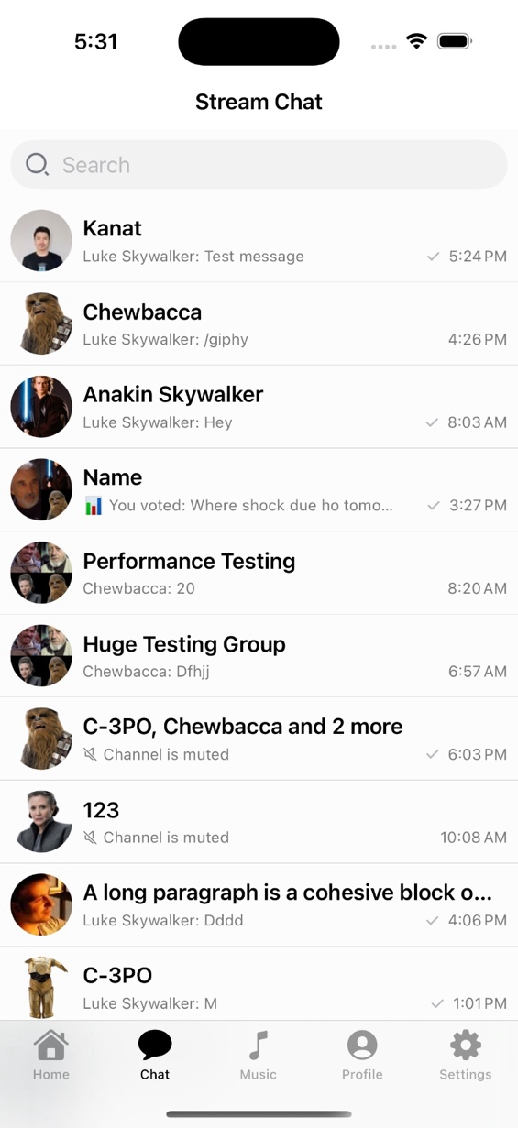
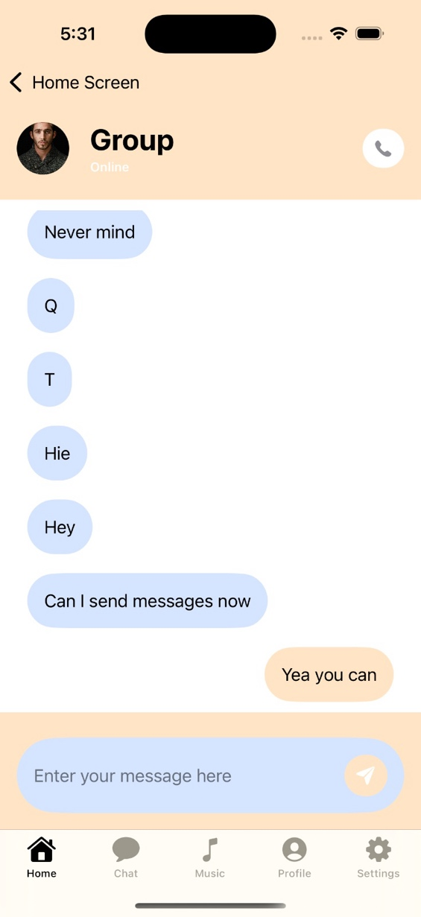

3.
4.
5.

Slide 11
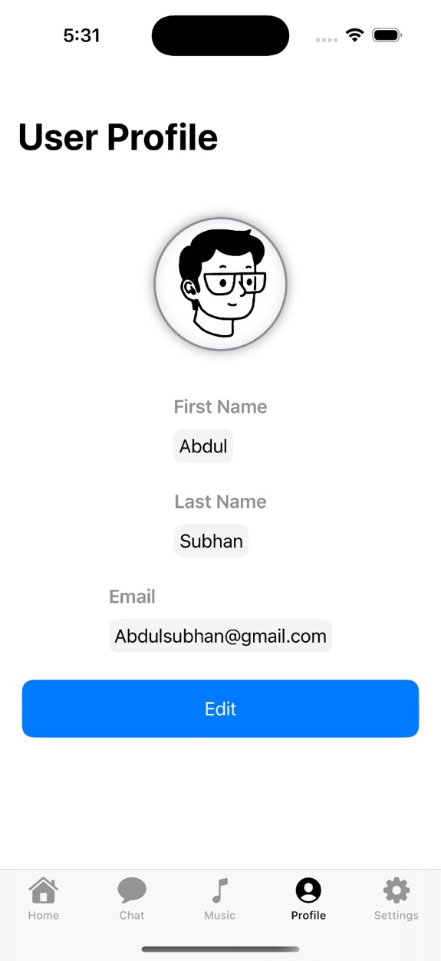
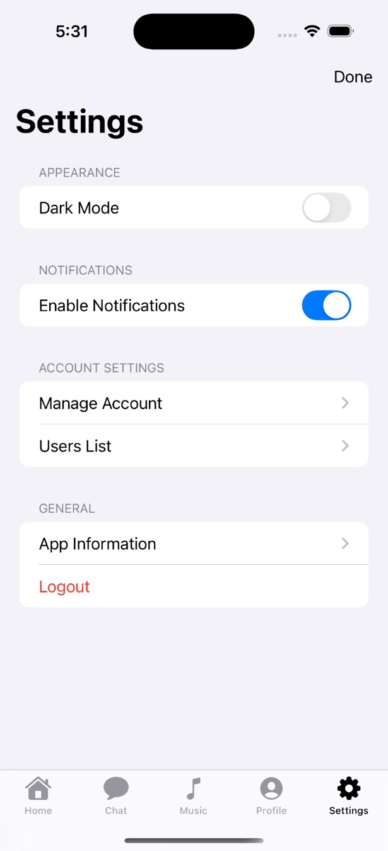
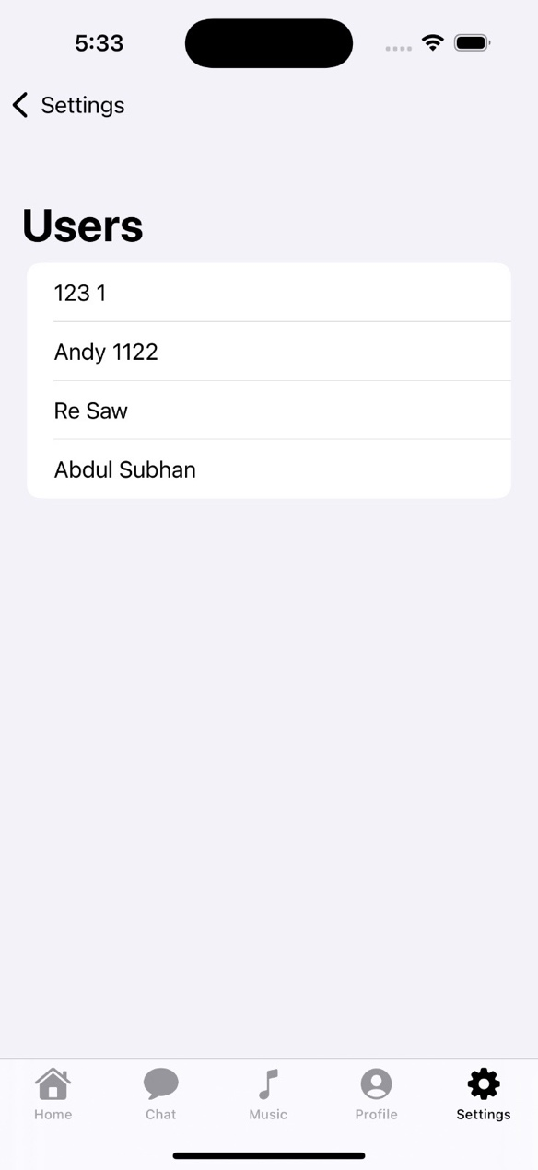

6.
7.
8.

Slide 12




Future Development Plans
App Integration
Expand app compatibility and partnerships.
AI-powered Features
Introduce personalized recommendations and insights.
Enhanced Security
Prioritize data privacy and secure user information.

Slide 13




AppDock: Simplifying Your Digital Life
1
Convenience
Efficiency
2
Organization and productivity.
Connectivity
3
Unified communication and sharing.

Slide 14
Conclusion
The project successfully addresses the problem of fragmented user experiences by offering:
A centralized hub for app organization.
Unified communication tools for individuals and groups.
Seamless content sharing capabilities.

Slide 15
Thank You

